Slide 1
Language Test
OLS

Slide 2
Registration and Login
You need to register at the link below, then you will receive a link to create a password for this account in your email.
https://academy.europa.eu/local/euacademy/pages/course/community-overview.php?title=learn-a-new-language
After creating an account, click on the link again and log in.
Follow the steps bellow.
After completing the test, it is necessary to make a print screen of its result and send it by e-mail to barbora.hoppova@vsb.cz

Slide 3
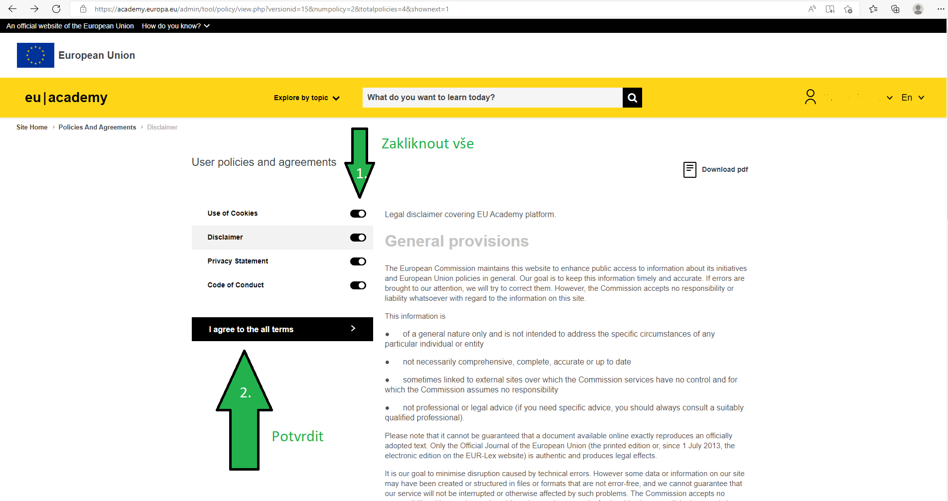

Slide 4
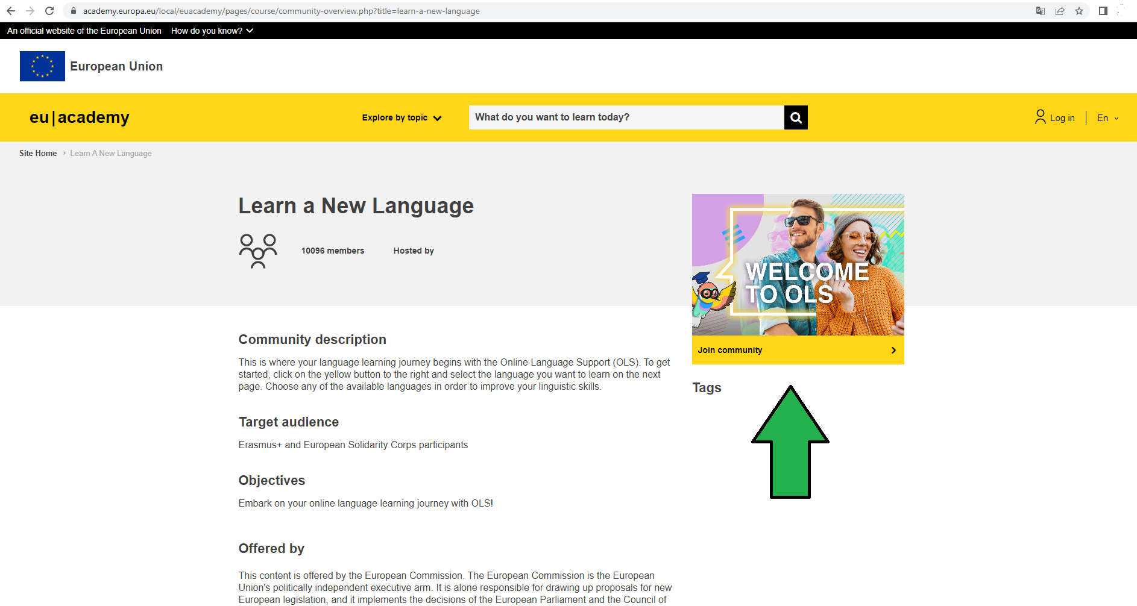

Slide 5
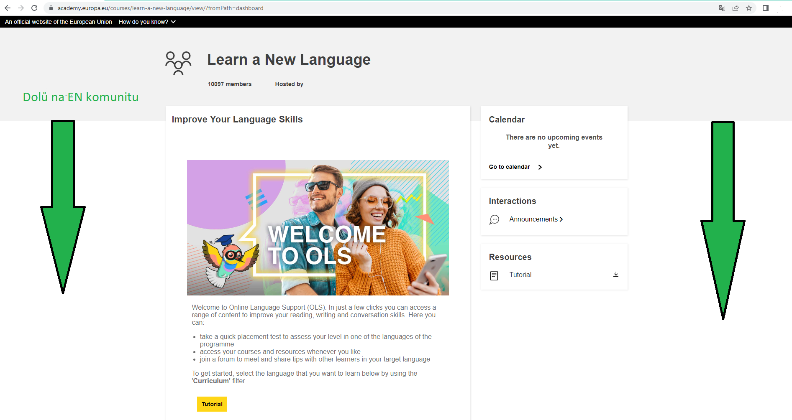

Slide 6
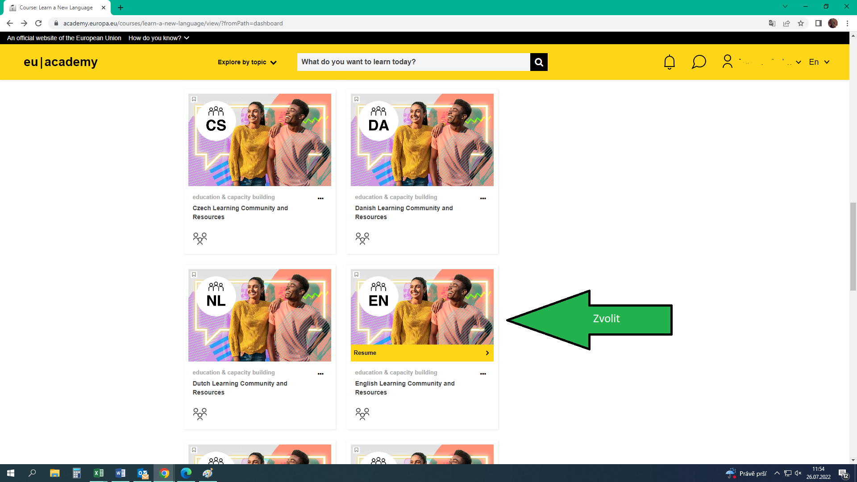

Slide 7
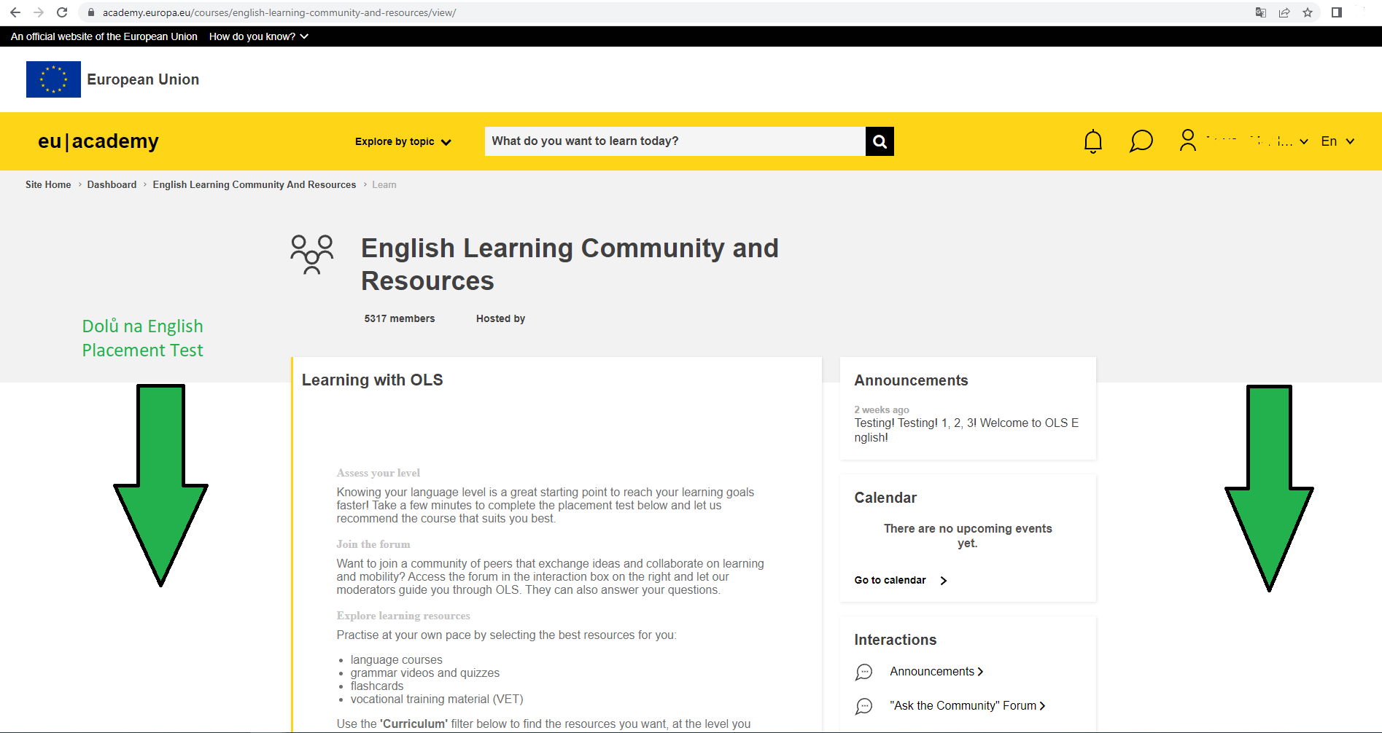

Slide 8
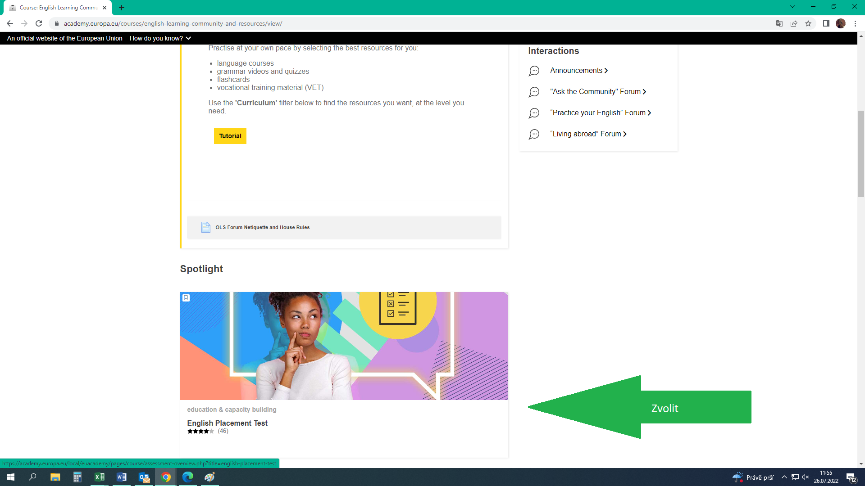

Slide 9
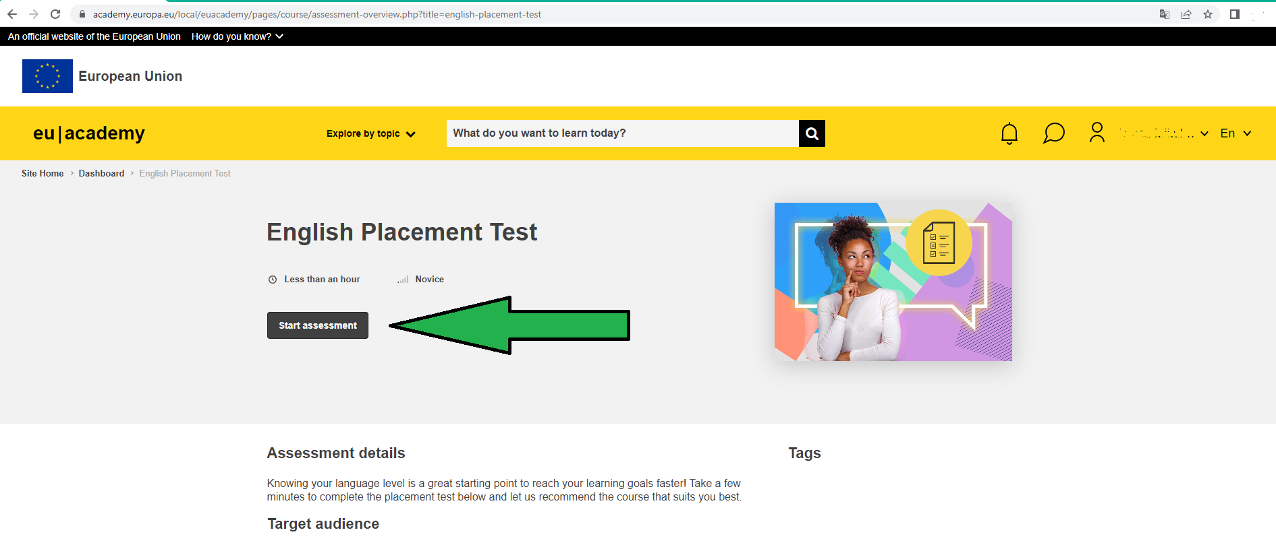

Slide 10
